Slide 1


Slide 2
HTML Fundamentals
Week 2

Slide 3
Recap of Previous Class
Topics Covered Previously
Introduction to Web Development
Static vs Dynamic Websites
Frontend vs Backend
Introduction to PHP
XAMPP & VS Code
First HTML & PHP Program

Slide 4
Learning Objectives
What Students Will Learn Today
Introduction to HTML
Structure of HTML Document
Basic HTML Tags
Lists & Tables
Hyperlinks & Images
HTML Forms
Input Controls
Semantic HTML Basics

Slide 5
What is HTML?
HyperText Markup Language
HTML is the standard language used to create webpages.
HTML is Used For:
Structuring webpages
Displaying content
Creating forms
Linking pages

Slide 6
Features of HTML
HTML Features
Easy to Learn
Platform Independent
Supports Multimedia
Works with CSS & JavaScript
Foundation of Web Development

Slide 7
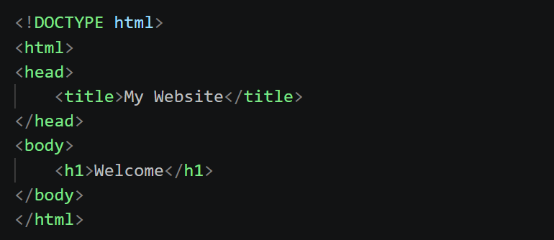
Structure of an HTML Document
Basic HTML Structure

Slide 8
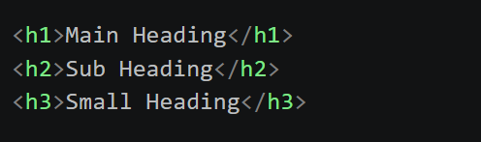
Headings in HTML
HTML Headings
Heading Levels
h1 → Largest
h6 → Smallest

Slide 9

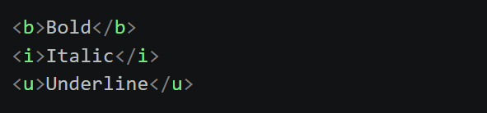
Paragraphs & Text Formatting
Paragraph Tag
Text Formatting Tags

Slide 10
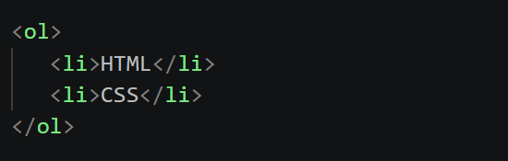
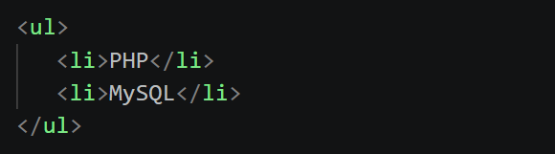
Lists in HTML
Ordered List
Unordered List

Slide 11
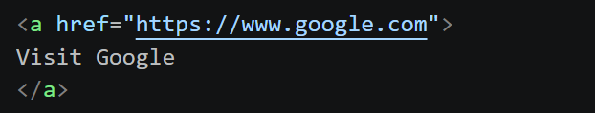
Hyperlinks in HTML
Anchor Tag
Uses
Navigate to Other Pages
Open External Websites

Slide 12
Images in HTML
Image Tag
Attributes
src
width
height
alt

